Slide 1
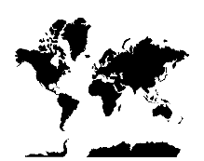




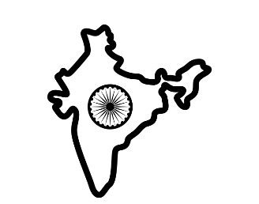



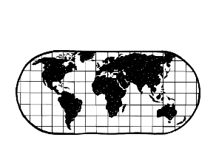

Where are areas of surplus and deficit located globally?
Ready for
High School
RE Learning Journey @ Studley St Marys
Term 3: Learning summary
Exploring the Holocaust and it’s impact on Jews
What are the origins of Shabbat?
Judaism and Christianity: what’s the link?
One church or many churches? What would be best?
Christian symbolism: why is it important?
Term 3: Judaism and the Holocaust
Term :s
History of Christianity: how did we get to where we are now?
How do the celebrations compare?
Where in the world? How Judaism fits into society today
What’s special about the synagogue?
Term 2: Learning summary
Baptism: how does it work? A comparison
Denominations: what are they and why so many?
Is Buddhism a religion?
Life of Buddha – writing an obituary (literacy link)
Denominations within religions
YEAR
Term 4: Do you have to be part of a community to express an organised worldview?
Buddhism in context: where it came from
What are the rules? The Eightfold Path in Buddhism – how does it fit?
Day in the life: comparing a strict religious life with a lay Buddhist
Nirvana: what it means to a Buddhist
Term 1: Learning summary
Who do Christians look to for influence and inspiration?
What makes someone a rebel? How does religion impact?
Where Hinduism fits into society today
Important teachings – where do they fit in?
Term 3: Learning summary
Karma and Samsara – the beliefs
Term 2: What can religion and worldviews tell us about conflict, peace, forgiveness and reconciliation and is that important?
Term 3: Why do Christians call the day Jesus died ‘Good Friday’?
Hindu creation stories
Extraordinary people and their religion: Individual project
People: MLK, MY,
MG,NM, MT
Rebel or inspiration? Can you be both?
Term 2: Learning Summary
Celebrations and festivals – making a comparison
10 commandments – living by the rules
Forgiveness – is it that easy? Comparing two stories
Temptation – what does it prove?
Interpretations of Heaven – an assessment
Where does the story begin? Creation
YEAR 2
3/4
Term 1:What kind of world did Jesus want?
Hinduism: One God, many gods – challenging misconceptions
Banished – what did Adam and Eve do?
10 commandments – how they form our modern laws
A new Messiah – what were the hopes?
Our attitudes and actions – the impact
Term 1: Learning summary
How might your religion lead you to do hard things for good reasons?
Creating our Spirited Art piece
Exploring Religious Art: An introduction to the Spirited Arts Competition (NATRE)
What is philosophy? Are we all philosophers?
Term 2: Learning summary
Term 5: What is it like to follow God (2)
Term 3: Learning summary – gallery entry for artwork – how it fits with this year’s learning
Planning our own competition entry (see current themes – NATRE)
Where can we search for answers to our own ‘big questions’?
Big questions: how can we answer them?
Term 4: What is it like to follow God?
Challenging misconceptions: the basics
Hajj: a religious journey
Extended writing – literacy link
Creating our own Islamic Art (cross-curricular)
The Five Pillars: Following Rules
Term 3: What or who is ‘God’ and how is the divine understood in theistic worldviews?
Recapping our misconceptions: a further challenge
Allah and Muhammad (PBUH):The importance
Ramadan: the impacts
Where does Islam fit into our society?
Islamic Art: where can we see it?
Term 1: Learning summary
The Golden Rule: who uses it?
What is Humanism? Belief systems
What makes up our world? (numeracy link)
What previous knowledge do we have?
YEAR 1
Term 2: What can Christians learn from the Creation Story
Term 1: How are nature and the seasons significant for religion and world views?
3/4
Using a religious text: how to find what’s relevant
Atheist or Agnostic? What does this mean?
What are the six major world religions?
What is fact? What is belief?
'Live life in all its fullness' John 10:10)

